Slide 1


Electric Circuits
Twelfth Edition, Global Edition
Chapter 4 – Part 2
Techniques of Circuit Analysis
© 2024 Pearson Education Ltd. All Rights Reserved.
Notes:
If this PowerPoint presentation contains mathematical equations, you may need to check that your computer has the following installed:
1) Math Type Plugin
2) Math Player (free versions available)
3) NVDA Reader (free versions available)

Slide 2
Chapter 4 – techniques of circuit analysis (1 of 26)
Node voltage method – special cases:
  The circuit contains one or more dependent sources
  The circuit has a branch that connects a non-reference essential node and the reference node, and this branch contains a voltage source only.
  The circuit has a branch that connects two non-reference essential nodes, and this branch contains a voltage source only.

Slide 3
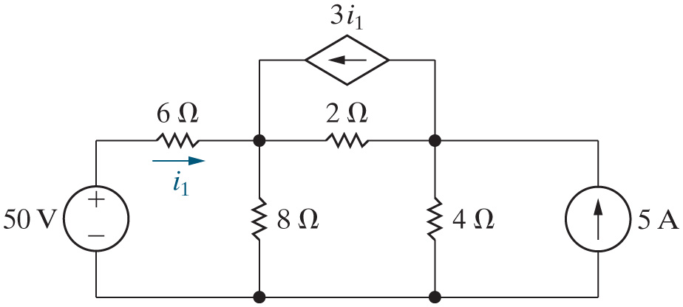
Chapter 4 – techniques of circuit analysis (2 of 26)
Node voltage method with dependent sources:
  Find the power associated with each source.

Slide 4
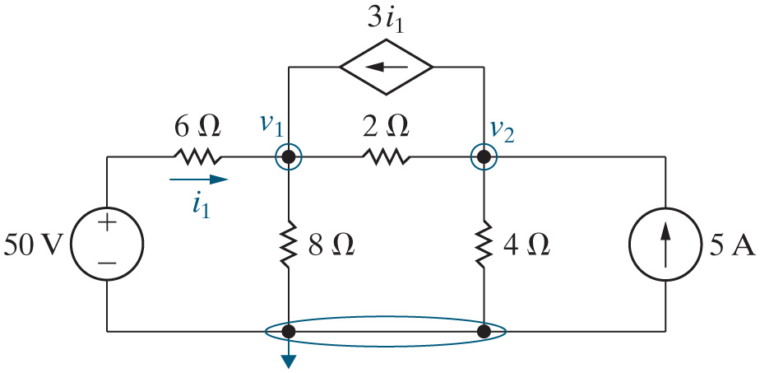
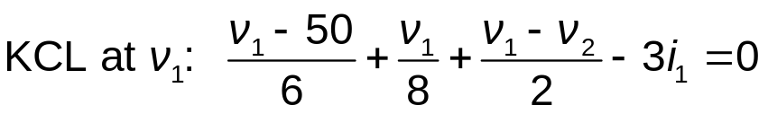
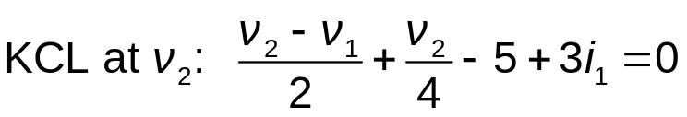
Chapter 4 – techniques of circuit analysis (3 of 26)
Node voltage method with dependent sources:
  Step 1 – Identify each essential node.
  Step 2 – Pick and label a reference node; then label the node voltages at the remaining essential nodes.
  Step 3 – Write a K C L equation for every nonreference essential node.
Notes:
Long Description 1:
K C L at v subscript 1 Base Line: Start Fraction v subscript 1 Base Line minus 50 over 6 End Fraction plus Start Fraction v subscript 1 Base Line over 8 End Fraction plus Start Fraction v subscript 1 Base Line minus v subscript 2 Base Line over 2 End Fraction minus 3 i subscript 1 Base Line equals 0.
Long Description 2:
K C L at v subscript 2 Base Line: Start Fraction v subscript 2 Base Line minus v subscript 1 Base Line over 2 End Fraction plus Start Fraction v subscript 2 Base Line over 4 End Fraction minus 5 plus 3 i subscript 1 Base Line equals 0.

Slide 5
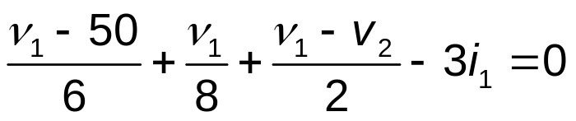
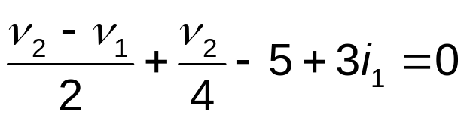


Chapter 4 – techniques of circuit analysis (4 of 26)
The two node voltage equations we just constructed are given below. How many unknowns do these equations contain?
A. 2
B. 3
C. 4
D. None of the above
Notes:
Long Description 1:
Start Fraction v subscript 1 Base Line minus 50 over 6 End Fraction plus Start Fraction v subscript 1 Base Line over 8 End Fraction plus Start Fraction v subscript 1 Base Line minus v subscript 2 Base Line over 2 End Fraction minus 3 i subscript 1 Base Line equals 0.
Long Description 2:
Start Fraction v subscript 2 Base Line minus v subscript 1 Base Line over 2 End Fraction plus Start Fraction v subscript 2 Base Line over 4 End Fraction minus 5 plus 3 i subscript 1 Base Line equals 0.

Slide 6
Chapter 4 – techniques of circuit analysis (5 of 26)
Node voltage method with dependent sources:
Need to modify the analysis method:
  Step 1 – Identify each essential node.
  Step 2 – Pick and label a reference node; then label the node voltages at the remaining essential nodes.
  Step 3 – Write a K C L equation for every nonreference essential node.
    If there are dependent sources, write a constraint equation for each one.
  Step 4 – Solve the equations to find the node-voltage values.
  Step 5 – Solve the circuit using node voltages from Step 4.

Slide 7
Chapter 4 – techniques of circuit analysis (6 of 26)
Node voltage method with dependent sources:
  Step 3, continued
    If there are dependent sources, write a constraint equation for each one.
  Step 4 – Solve the equations to find the node-voltage values.

Slide 8
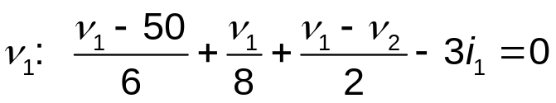
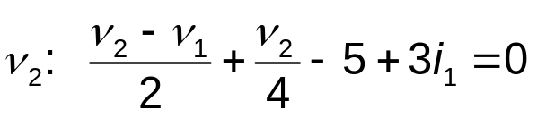
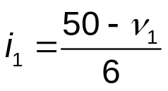
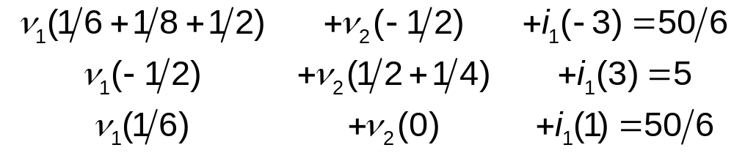

Chapter 4 – techniques of circuit analysis (7 of 26)
Note that the constraint equation defines the controlling variable of the dependent source in terms of the node voltages.
K C L at
K C L at
dep. source constraint:
Std form:
Solving:
Notes:
Long Description 1:
v subscript 1 Base Line: Start Fraction v subscript 1 Base Line minus 50 over 6 End Fraction plus Start Fraction v subscript 1 Base Line over 8 End Fraction plus Start Fraction v subscript 1 Base Line minus v subscript 2 Base Line over 2 End Fraction minus 3 i subscript 1 Base Line equals 0.
Long Description 2:
v subscript 2 Base Line: Start Fraction v subscript 2 Base Line minus v subscript 1 Base Line over 2 End Fraction plus Start Fraction v subscript 2 Base Line over 4 End Fraction minus 5 plus 3 i subscript 1 Base Line equals 0.
Long Description 3:
Line 1: v subscript 1 Base Line Open Parenthesis 1 divided by 6 plus 1 divided by 8 plus 1 divided by 2 Close Parenthesis, positive v subscript 2 Base Line Open Parenthesis negative 1 divided by 2 Close Parenthesis, positive i subscript 1 Base Line Open Parenthesis negative 3 Close Parenthesis equals 50 divided by 6.
Line 2: v subscript 1 Base Line Open Parenthesis negative 1 divided by 2 Close Parenthesis, positive v subscript 2 Base Line Open Parenthesis 1 divided by 2 plus 1 divided by 4 Close Parenthesis, positive i subscript 1 Base Line Open Parenthesis 3 Close Parenthesis equals 5.
Line 3: v subscript 1 Base Line Open Parenthesis 1 divided by 6 Close Parenthesis, positive v subscript 2 Base Line Open Parenthesis 0, positive plus i subscript 1 Base Line Open Parenthesis 1 Close Parenthesis equals 50 divided by 6.

Slide 9
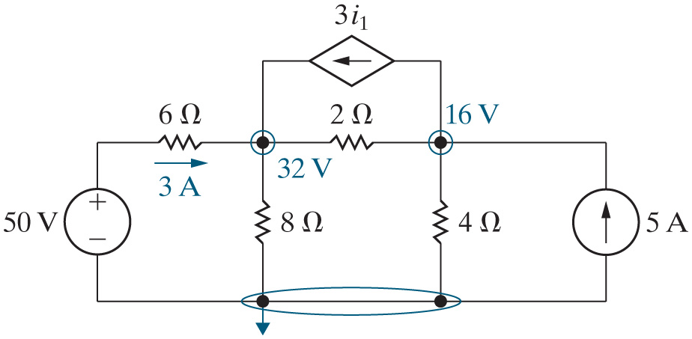








Chapter 4 – techniques of circuit analysis (8 of 26)
Step 5 – Solve the circuit using node voltages from Step 4.
From the power balance, we find the power for each source.
Component | Equation | p[W]
50 V | −(3)(50) | −150
5 A | −(5)(16) | −80
Dep. Source | −[3(3)](32 – 16) | −144
6 Ohms. | Open Parenthesis 3 Close Parenthesis squared multiplied by Open Parenthesis 6 Close Parenthesis. | 54
2 Ohms. | Open Parenthesis 32 minus 16 Close Parenthesis squared divided by 2. | 128
8 Ohms. | Open Parenthesis 32 Close Parenthesis squared divided by 8. | 128
4 Ohms. | Open Parenthesis 16 Close Parenthesis squared divided by 4. | 64

Slide 10
Chapter 4 – techniques of circuit analysis (9 of 26)
In the circuit we just analyzed, all of the sources are delivering power to the circuit.
A. True
B. False

Slide 11

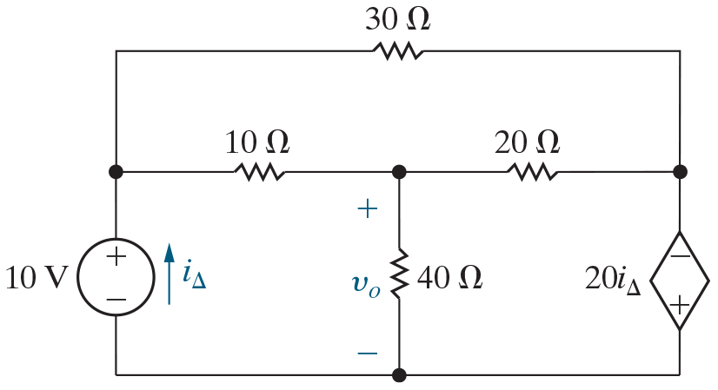
Chapter 4 – techniques of circuit analysis (10 of 26)
Node voltage method with a voltage source alone in a branch:
  Find the voltage

Slide 12
Chapter 4 – techniques of circuit analysis (11 of 26)
How many essential nodes does this circuit contain?
A. 2
B. 3
C. 4
D. 5

Slide 13
Chapter 4 – techniques of circuit analysis (11 of 26)
How many essential nodes does this circuit contain?
A. 2
B. 3
C. 4
D. 5

Slide 14


Chapter 4 – techniques of circuit analysis (12 of 26)
The dependent source constraint equation must define the value of which variable?
A.
B.
C. The voltage across the dependent source
D. The reference voltage

Slide 15
Chapter 4 – techniques of circuit analysis (12 of 26)
The dependent source constraint equation must define the value of which variable?
A.
B.
C. The voltage across the dependent source
D. The reference voltage

Slide 16

Chapter 4 – techniques of circuit analysis (13 of 26)
If the essential node at the bottom of the circuit is the reference node, what is the voltage at the middle left node with respect to the reference node?
A.
B.
C. 10 V
D. It is unknown

Slide 17
Chapter 4 – techniques of circuit analysis (13 of 26)
If the essential node at the bottom of the circuit is the reference node, what is the voltage at the middle left node with respect to the reference node?
A.
B.
C. 10 V
D. It is unknown

Slide 18


Chapter 4 – techniques of circuit analysis (14 of 26)
If the essential node at the bottom of the circuit is the reference node, what is the voltage at the middle right node with respect to the reference node?
A.
B.
C. 10 V
D.

Slide 19
Chapter 4 – techniques of circuit analysis (14 of 26)
If the essential node at the bottom of the circuit is the reference node, what is the voltage at the middle right node with respect to the reference node?
A.
B.
C. 10 V
D.

Slide 20
Chapter 4 – techniques of circuit analysis (15 of 26)
Node voltage analysis method, modified again:
  Step 1 – Identify each essential node.
  Step 2 – Pick and label a reference node; then label the node voltages at the remaining essential nodes.
    If a voltage source is the only element between an essential node and the reference node, replace the node voltage label with the value of the voltage source.
  Step 3 – Write a K C L equation for every nonreference essential node where the voltage is unknown.
    If there are dependent sources, write a constraint equation for each one.
  Step 4 – Solve the equations to find the node-voltage values.
  Step 5 – Solve the circuit using node voltages from Step 4.

Slide 21
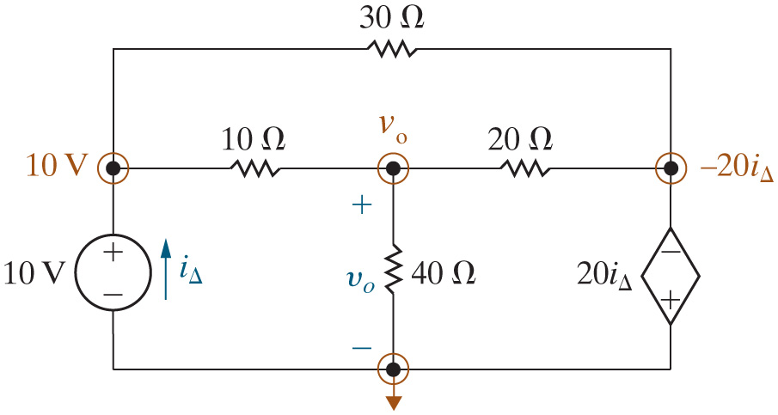
Chapter 4 – techniques of circuit analysis (16 of 26)
Node voltage method with a voltage source alone in a branch:
  After Steps 1 and 2:

Slide 22
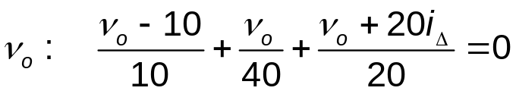
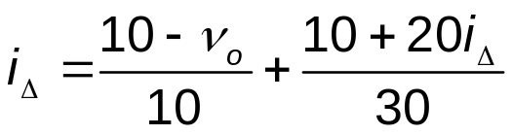
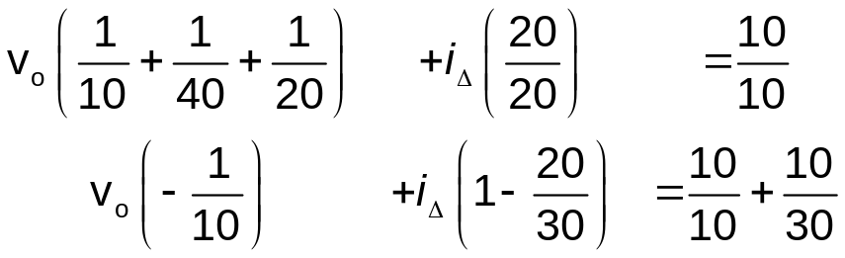


Chapter 4 – techniques of circuit analysis (17 of 26)
Node voltage method with a voltage source alone in a branch:
  Step 3 (write the K C L and constraint equations) and Step 4 (solve the equations):
At
constraint:
S t d. form:
Solution:
Notes:
Long Description 1:
v subscript o Base Line: Start Fraction v subscript o Base Line minus 10 over 10 End Fraction plus Start Fraction v subscript o Base Line over 40 End Fraction plus Start Fraction v subscript o Base Line plus 20 i subscript uppercase Delta over 20 End Fraction equals 0.
Long Description 2:
Constraint: i subscript uppercase Delta Base Line equals Start Fraction 10 minus v subscript o Base Line over 10 End Fraction plus Start Fraction 10 plus 20 i subscript uppercase Delta over 30 End Fraction.
Long Description 3:
Line 1: v subscript o Base Line Open Parenthesis Start Fraction 1 over 10 End Fraction plus Start Fraction 1 over 40 End Fraction plus Start Fraction 1 over 20 End Fraction Close Parenthesis plus i subscript uppercase Delta Base Line Open Parenthesis Start Fraction 20 over 20 End Fraction Close Parenthesis equals Start Fraction 10 over 10 End Fraction.
Line 2: v subscript o Base Line Open Parenthesis negative Start Fraction 1 over 10 End Fraction Close Parenthesis plus i subscript uppercase Delta Base Line Open Parenthesis 1 minus Start Fraction 20 over 30 End Fraction Close Parenthesis equals Start Fraction 10 over 10 End Fraction plus Start Fraction 10 over 30 End Fraction.

Slide 23








Chapter 4 – techniques of circuit analysis (18 of 26)
Power balance:
Component | Equation | p [W]
10 V | −(10)(−3.2) | 32
Dep. Source | −[−3.2 – 24/40][20(−3.2)] | −243.2
30 Ohms. | Open SquareBracket negative 20 Open Parenthesis negative 3.2 Close Parenthesis minus 10 Close SquareBracket squared divided by 30. | 97.2
10 Ohms. | Open Parenthesis 24 minus 10 Close Parenthesis squared divided by 10. | 19.6
20 Ohms. | Open SquareBracket 24 plus 20 Open Parenthesis negative 3.2 Close Parenthesis Close SquareBracket squared divided by 20. | 80
40 Ohms. | 24 squared divided by 40. | 14.4

Slide 24

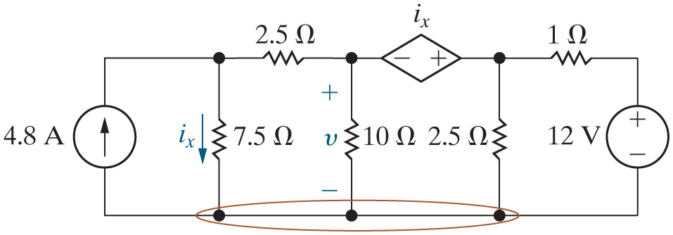
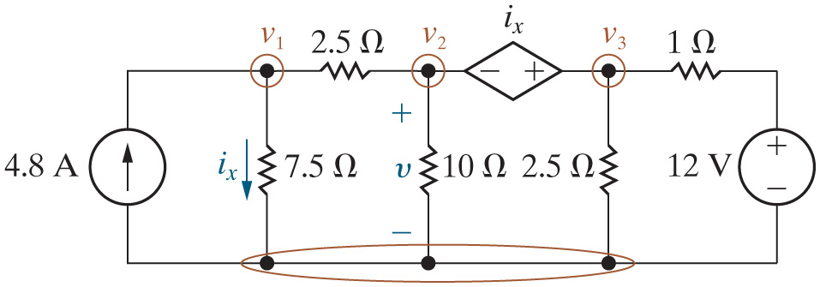
Chapter 4 – techniques of circuit analysis (19 of 26)
Node voltage method with a voltage source between two non-reference essential nodes:
  Find the voltage
After Steps 1 and 2,

Slide 25

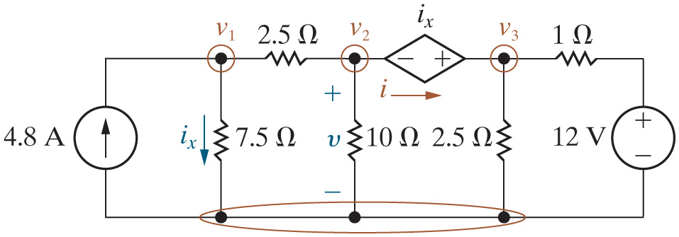
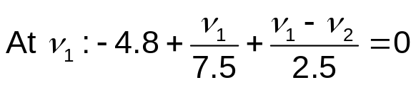
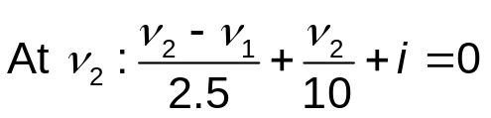
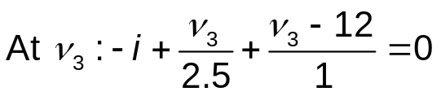
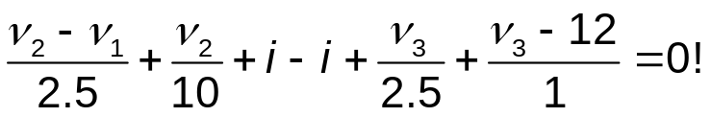
Chapter 4 – techniques of circuit analysis (20 of 26)
Node voltage method with a voltage source between two non-reference essential nodes:
  Step 3 – Write the K C L equations. To do this, introduce a
unknown, i.
Sum the last two equations to eliminate i:
Notes:
Long Description:
Start Fraction v subscript 2 Base Line minus v subscript 1 Base Line over 2.5 End Fraction plus Start Fraction v subscript 2 Base Line over 10 End Fraction plus i minus i plus Start Fraction v subscript 3 Base Line over 2.5 End Fraction plus Start Fraction v subscript 3 Base Line minus 12 over 1 End Fraction equals 0 factorial.

Slide 26
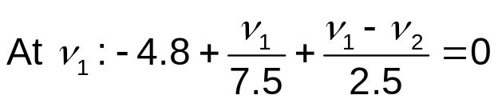
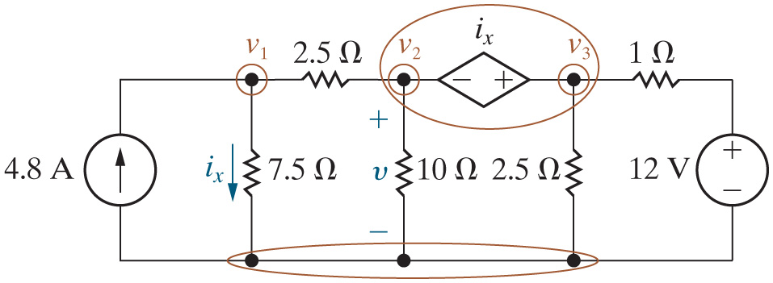
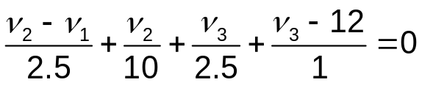

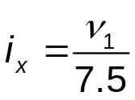
Chapter 4 – techniques of circuit analysis (21 of 26)
Node voltage method with a supernode:
  Instead of introducing another unknown, combine the two essential nodes and the voltage source in the branch between them into a single supernode. Then in Step 3, write a K C L equation for the supernode and a constraint equation for the supernode.
At supernode:
S N constraint:
Dep source constraint:
Notes:
Long Description:
Start Fraction v subscript 2 Base Line minus v subscript 1 Base Line over 2.5 End Fraction plus Start Fraction v subscript 2 Base Line over 10 End Fraction plus Start Fraction v subscript 3 Base Line over 2.5 End Fraction plus Start Fraction v subscript 3 Base Line minus 12 over 1 End Fraction equals 0.

Slide 27
Chapter 4 – techniques of circuit analysis (22 of 26)
Node voltage analysis method, final version
  Step 1 – Identify each essential node.
  Step 2 – Pick and label a reference node; then label the node voltages at the remaining essential nodes.
    If a voltage source is the only element between an essential node and the reference node, replace the node voltage label with the value of the voltage source.
    If a voltage source is the only element between two nonreference essential nodes, combine the nodes and the source into a single supernode.
  Step 3 – Write a K C L equation for each supernode and for every remaining nonreference essential node where the voltage is unknown.
    If there are dependent sources, write a constraint equation for each one.
    If there are supernodes, write a constraint equation for each one.
  Step 4 – Solve the equations to find the node-voltage values.
  Step 5 – Solve the circuit using node voltages from Step 4.

Slide 28

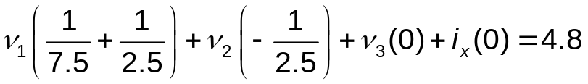
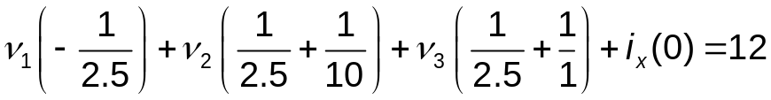

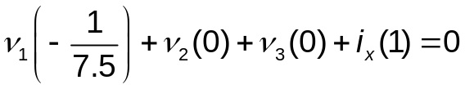




Chapter 4 – techniques of circuit analysis (23 of 26)
Node voltage method with a super node:
  Find the voltage
Step 4 – Solve the equations (using standard form):
Notes:
Long Description 1:
v subscript 1 Base Line Open Parenthesis 1 divided by 7.5 plus 1 divided by 2.5 Close Parenthesis plus v subscript 2 Base Line Open Parenthesis negative 1 divided by 2.5 Close Parenthesis plus v subscript 3 Base Line Open Parenthesis 0 Close Parenthesis plus i subscript x Base Line Open Parenthesis 0 Close Parenthesis equals 4.8.
Long Description 2:
v subscript 1 Base Line Open Parenthesis negative 1 divided by 2.5 Close Parenthesis plus v subscript 2 Base Line Open Parenthesis 1 divided by 2.5 plus 1 divided by 10 Close Parenthesis plus v subscript 3 Base Line Open Parenthesis 1 divided by 2.5 plus 1 divided by 1 Close Parenthesis plus i subscript x Base Line Open Parenthesis 0 Close Parenthesis equals 12.
Long Description 3:
v subscript 1 Base Line Open Parenthesis 0 Close Parenthesis plus v subscript 2 Base Line Open Parenthesis negative 1 Close Parenthesis plus v subscript 3 Base Line Open Parenthesis 1 Close Parenthesis plus i subscript x Base Line Open Parenthesis negative 1 Close Parenthesis equals 0.
Long Description 4:
v subscript 1 Base Line Open Parenthesis negative 1 divided by 7.5 Close Parenthesis plus v subscript 2 Base Line Open Parenthesis 0 Close Parenthesis plus v subscript 3 Base Line Open Parenthesis 0 Close Parenthesis plus i subscript x Base Line Open Parenthesis 1 Close Parenthesis equals 0.

Slide 29
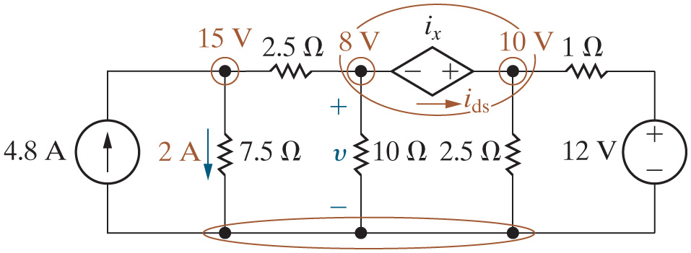
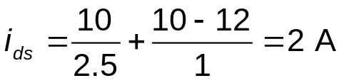









Chapter 4 – techniques of circuit analysis (24 of 26)
Power balance:
Component | Equation | p [W]
4.8 A | −(4.8)(15) | −72
Dep. Source | −(2)(2) | −4
12 V | (12)(10 – 12)/1 | −24
7.5 Ohms. | Open Parenthesis 2 Close Parenthesis squared multiplied by Open Parenthesis 7.5 Close Parenthesis. | 30
2.5 Ohms Open Parenthesis top Close Parenthesis. | Open Parenthesis 15 minus 8 Close Parenthesis squared divided by 2.5. | 19.6
10 Ohms. | Open Parenthesis 8 Close Parenthesis squared divided by 10. | 6.4
2.5 Ohms. | Open Parenthesis 10 Close Parenthesis squared divided by 2.5. | 40
1 Ohm. | Open Parenthesis 10 minus 12 Close Parenthesis squared divided by 1. | 4

Slide 30
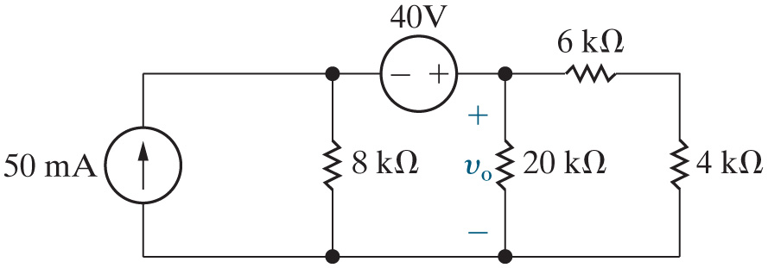
Chapter 4 – techniques of circuit analysis (25 of 26)
How many super nodes does this circuit contain?
A. 0
B. 1
C. 2

Slide 31
Chapter 4 – techniques of circuit analysis (25 of 26)
How many super nodes does this circuit contain?
A. 0
B. 1
C. 2

Slide 32
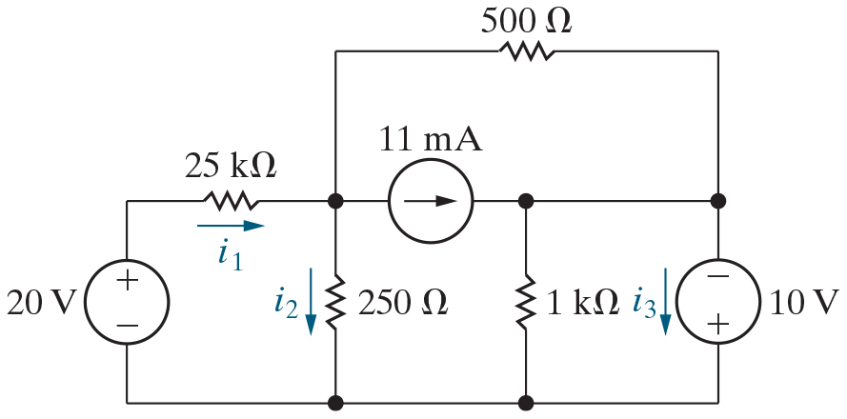
Chapter 4 – techniques of circuit analysis (26 of 26)
How many super nodes does this circuit contain?
A. 0
B. 1
C. 2

Slide 33
Chapter 4 – techniques of circuit analysis (26 of 26)
How many super nodes does this circuit contain?
A. 0
B. 1
C. 2

Slide 34

Copyright
This work is protected by United Kingdom copyright laws and is provided solely for the use of instructors in teaching their courses and assessing student learning. Dissemination or sale of any part of this work (including on the World Wide Web) will destroy the integrity of the work and is not permitted. The work and materials from it should never be made available to students except by instructors using the accompanying text in their classes. All recipients of this work are expected to abide by these restrictions and to honor the intended pedagogical purposes and the needs of other instructors who rely on these materials.

